Slide 1
Marketiing Analytics Midterm Project - Team 2
Wen Zhang, Troy zhen, Levent Kayın

Slide 2
Pernalonga is a leading supermarket chain in basil
They want to improve their promotion strategy
Over 400 stores in Brazil
Over 10 thousand products
Over 400 categories.
Partnerships with suppliers to fund promotions
30% of its sales on promotions
Mostly in store promotions
Push into personalised promotions

Slide 3
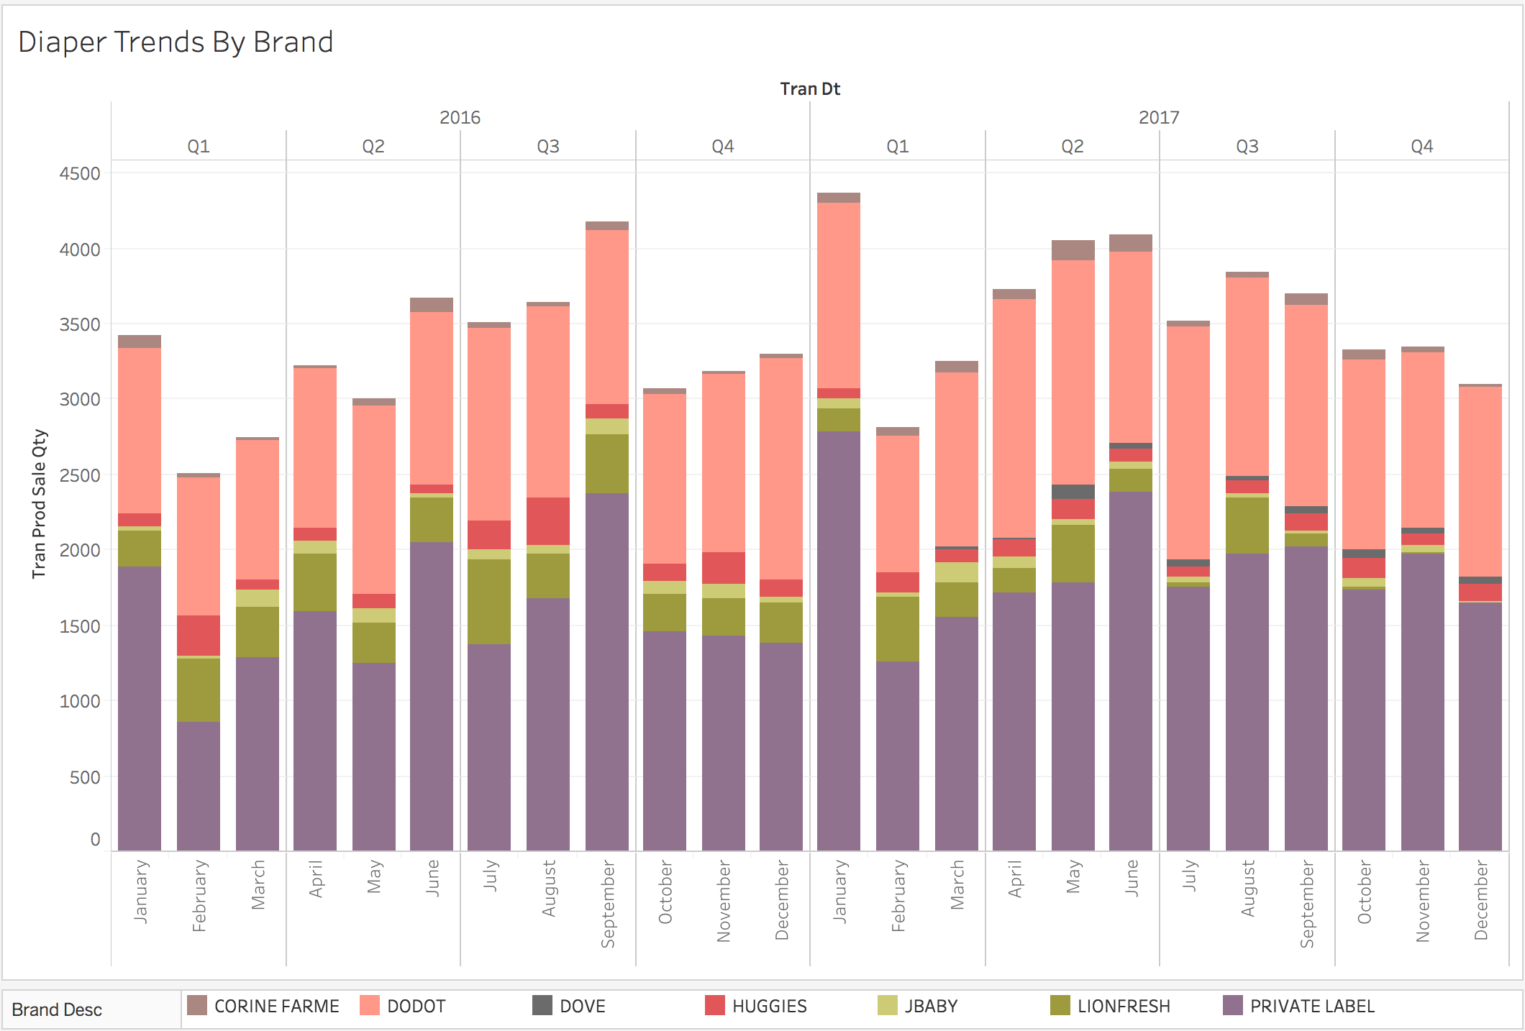
Diaper Market in Pernalonga is competitive
Pernaloga’s Private label and dodot seem to dominate the market

Slide 4
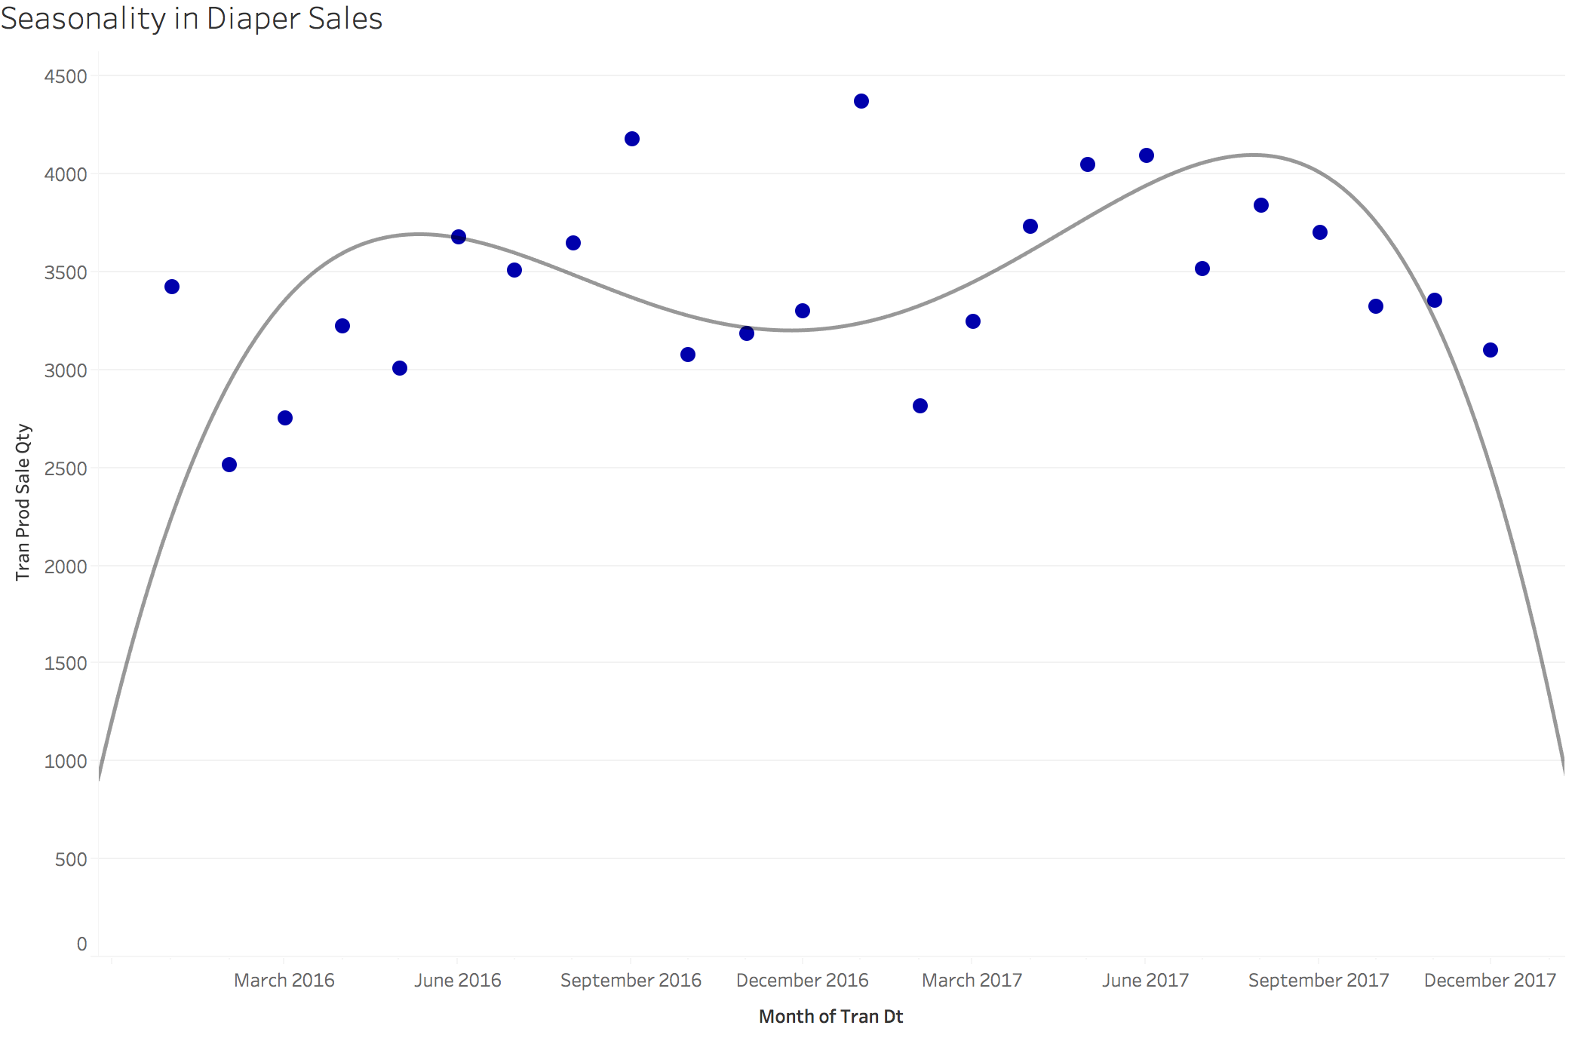
Diaper and baby hygiene product sales are seasonal
however this is due to the seasonality in human reproduction, on a customer level people don’T behave seasonally

Slide 5
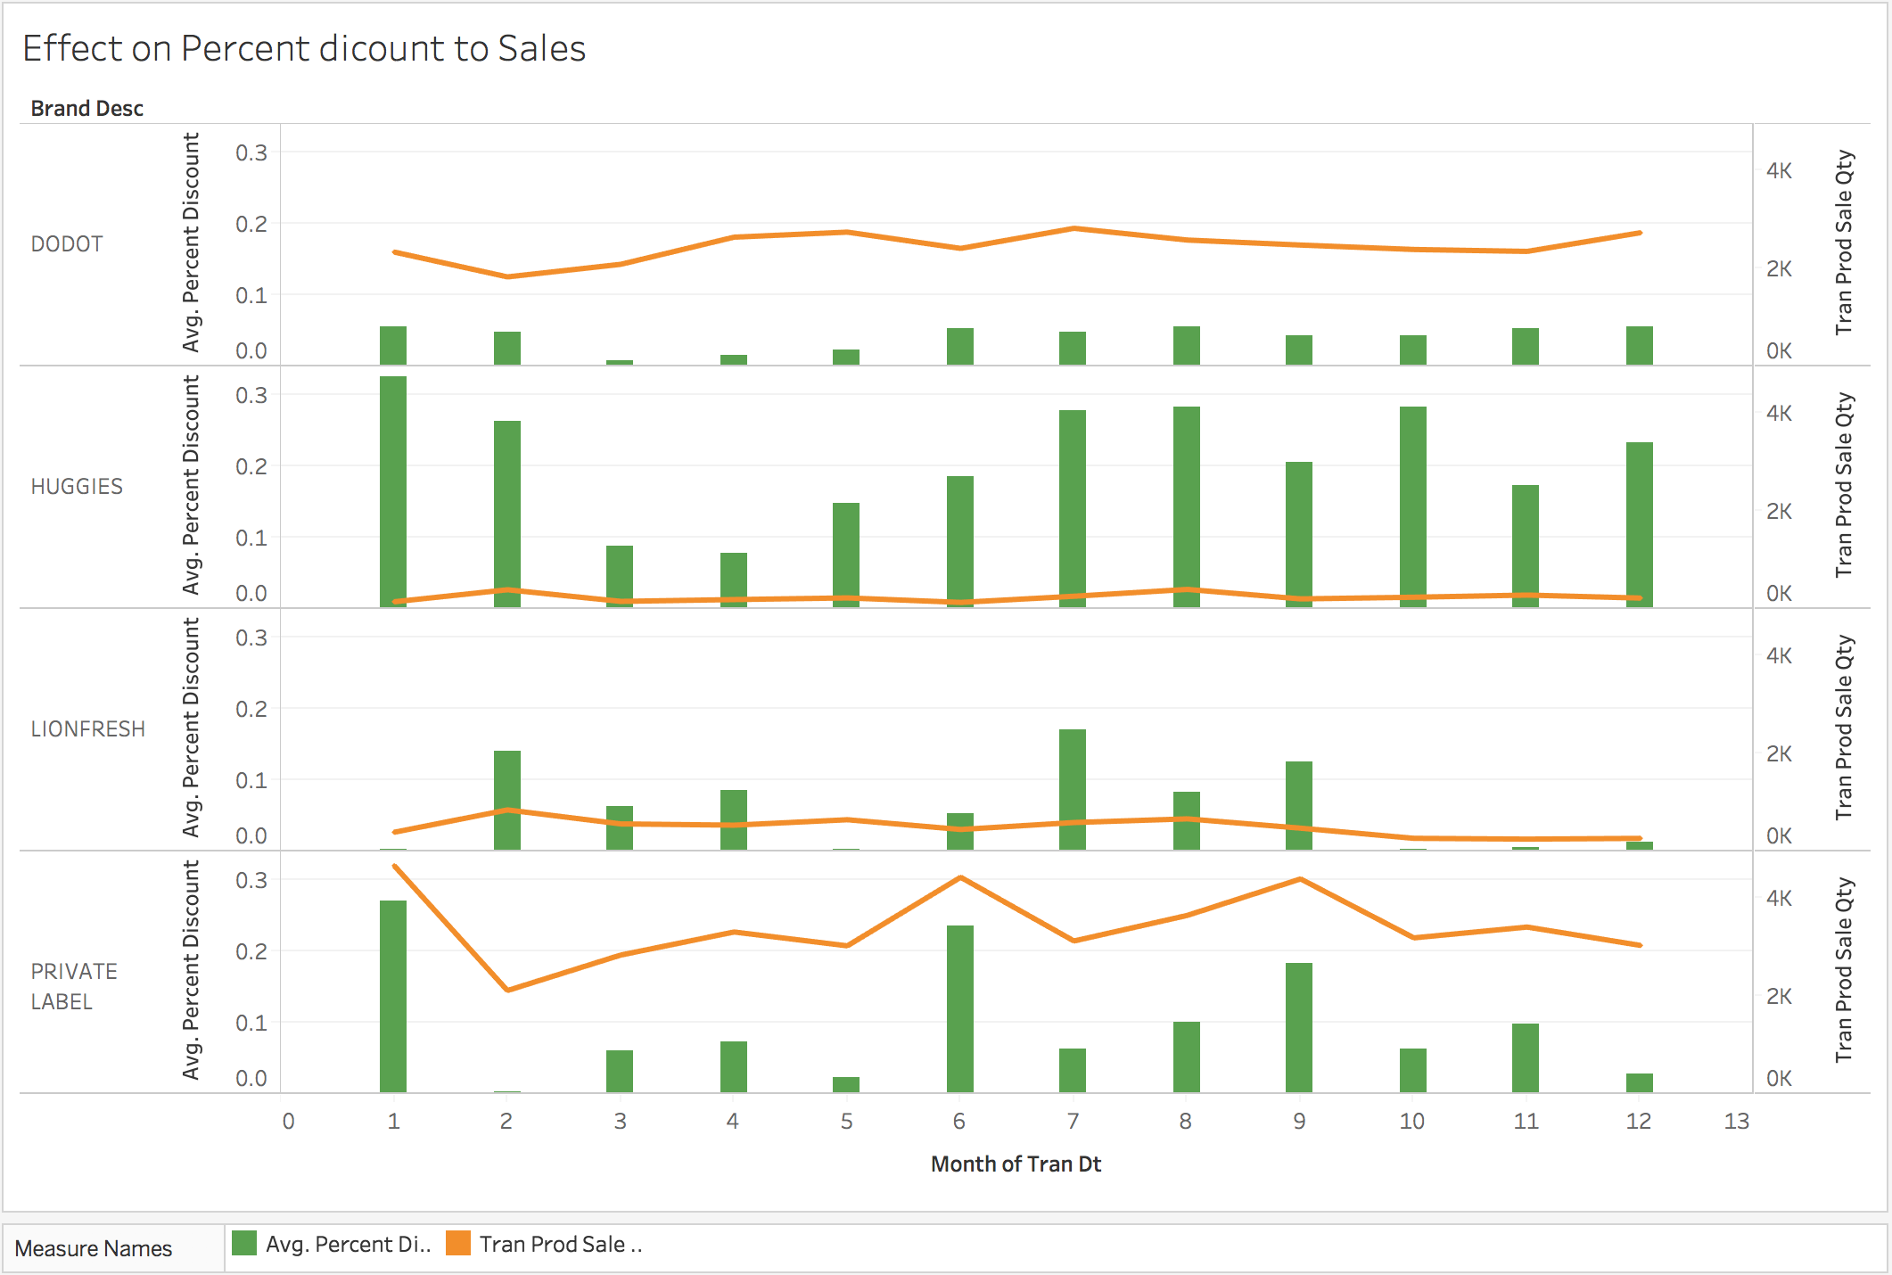
Brands employ different discount strategies
Some are more effective in increasing sales

Slide 6
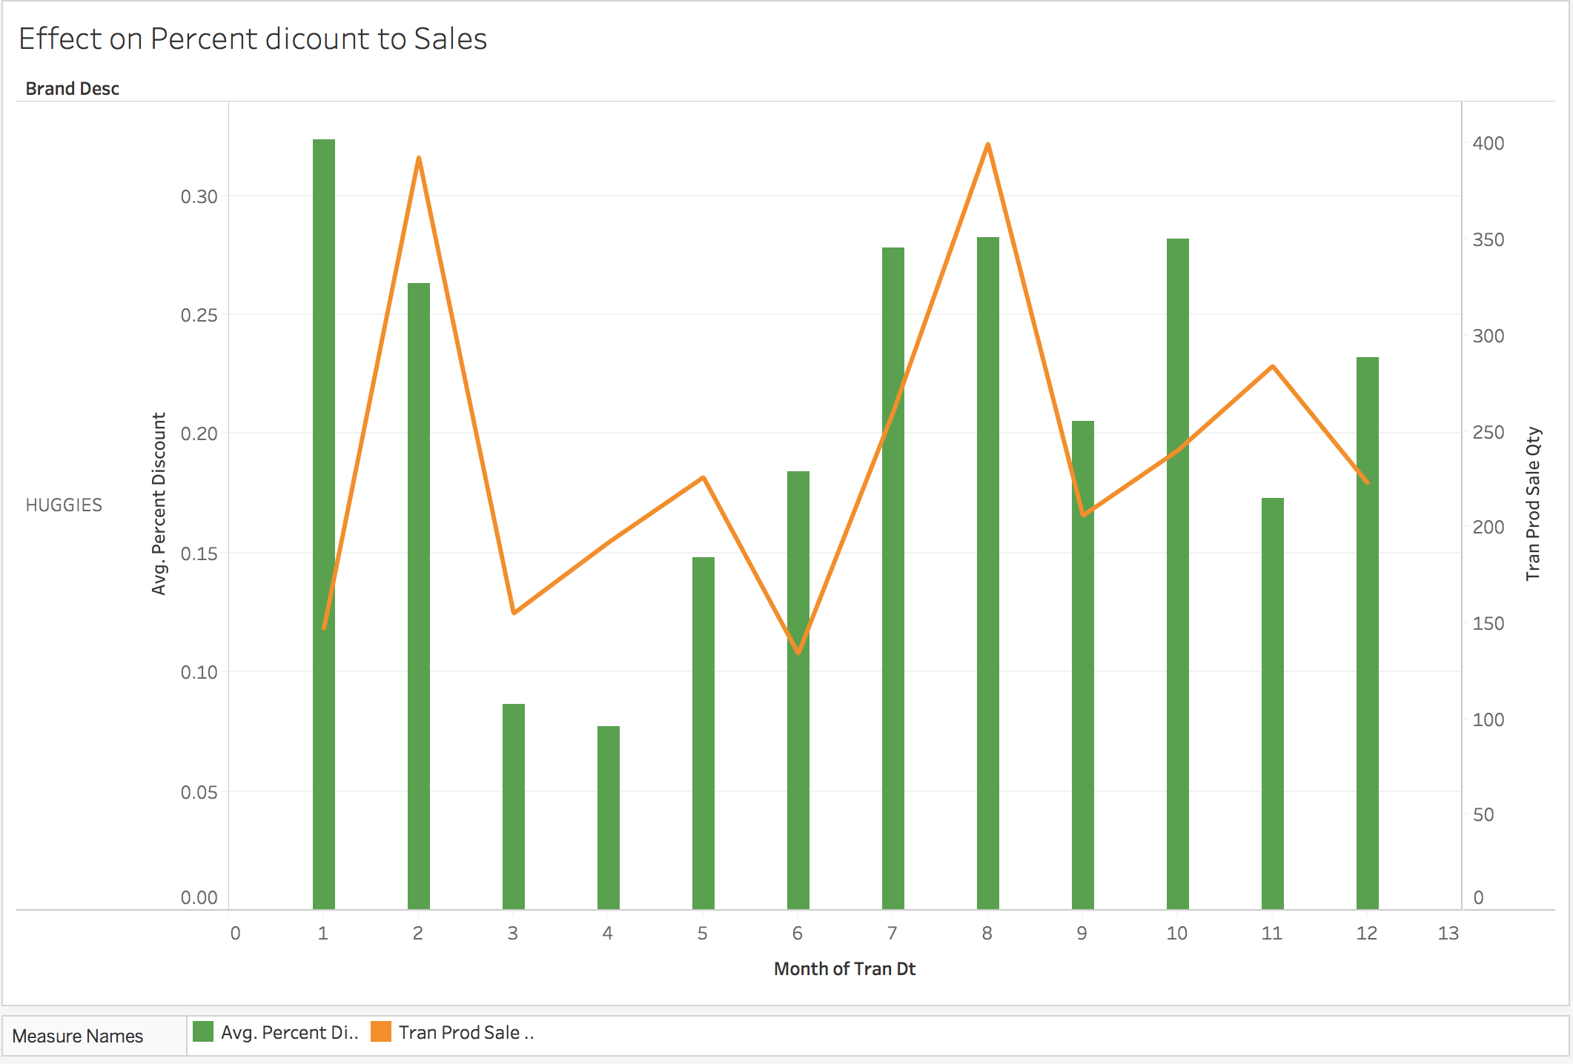
Huggies’ Promotion strategy does not seem to capture sales
They have a rigid customer segment and the changes seems to be due to seasonality

Slide 7
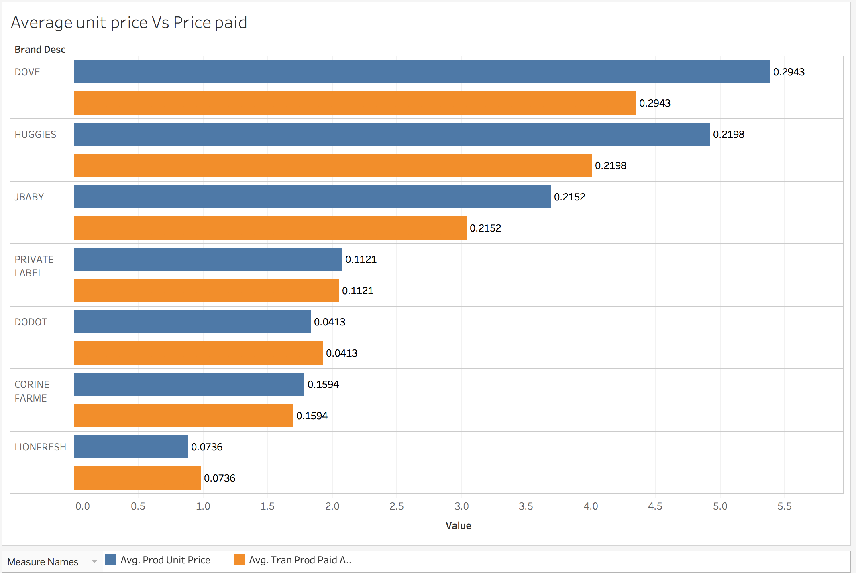
huggies might learn best practices from customers
Dodot seems to be pricing and promoting to bring more sales

Slide 8
personalised promotions might will help huggies
Huggies needs to break out from their rigid customer base
Identifying customers that are likely to switch to Huggies
Personalised promotions to attract and retain customers
Ideally needs to be coupled with a robust pricing strategy for sustainability

Slide 9
We can use machine Learning to Target Customers
Preprocessing is necessary and useful
We used R to preprocess the data.
Merged two data tables, joined the tables on product id
Created some new variables that we thought would be beneficial.
Customer value variable captures the total value of that customer to Pernalonga
Customer tier variable helps us rank the customers based on the value they bring to Pernalonga.
Separated tables to show only look at diapers and baby hygiene products

